Slide 1
References for Linear Algebra
Chng Eng Siong
10 Aug 2020
Last edited: 16 Dec 2024

Slide 2
Full Courses on LA that have same focus
1) Gilbert Strang: 2011 whole course
https://youtube.com/playlist?list=PL221E2BBF13BECF6C&si=8XH8qPVl6dPGWjiw
https://ocw.mit.edu/courses/18-06sc-linear-algebra-fall-2011/pages/resource-index/
2) Francisco J. Rodríguez Fortuño Paco - Kings college London
Chapter 1& 2: https://youtube.com/playlist?list=PLVud-bSBOEpwTawKgB36JoQxrc7KCrPe0&si=2m2OIA0T63Zq6ZND
https://nms.kcl.ac.uk/francisco.rodriguez/apuntespak/docs/kcl/Mathematics%20and%20Computation%20Collected%20Notes%202018-19.pdf

Slide 3
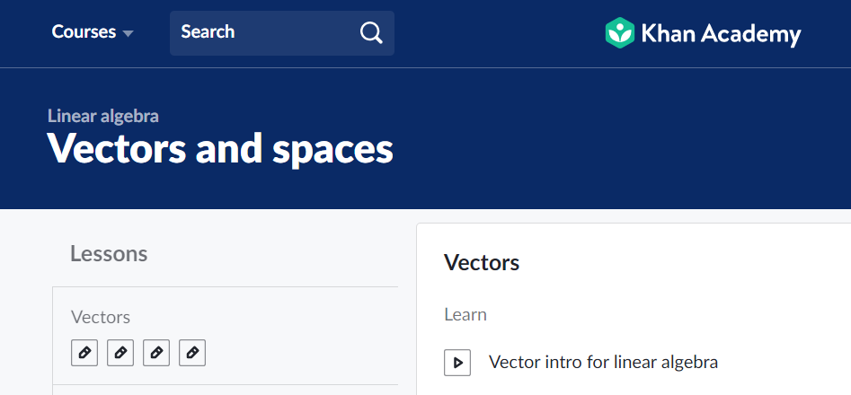
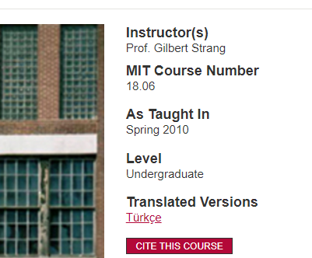

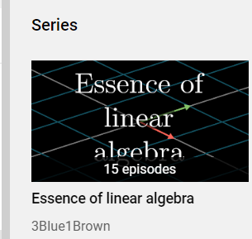
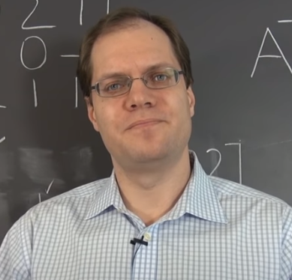
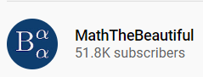

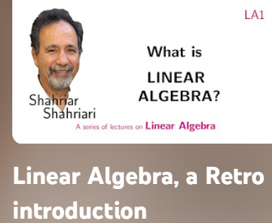
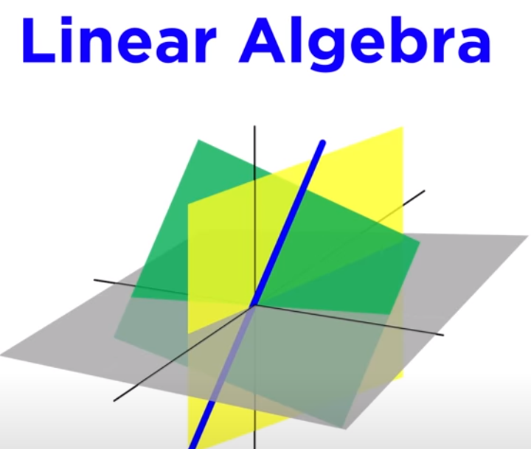
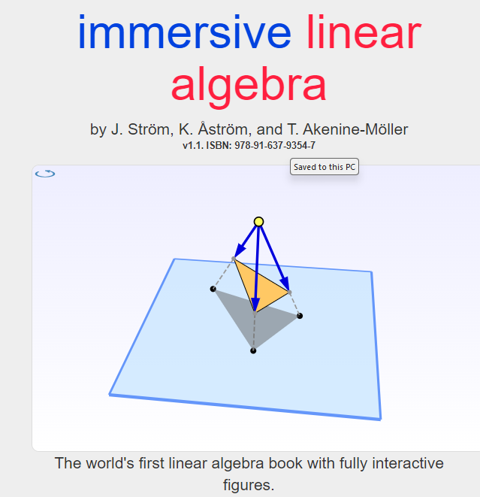

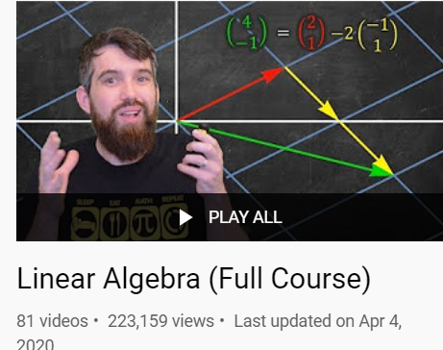
Other useful Playlist
Khan Academy: https://www.khanacademy.org/math/linear-algebra/
MIT Strang 18.06: https://ocw.mit.edu/courses/mathematics/18-06-linear-algebra-spring-2010/video-lectures/
3Blue1Brown: https://www.youtube.com/playlist?list=PLZHQObOWTQDPD3MizzM2xVFitgF8hE_ab
Trevor Bazett: https://www.youtube.com/playlist?list=PLHXZ9OQGMqxfUl0tcqPNTJsb7R6BqSLo6
MathsTheBeautiful: https://www.youtube.com/watch?v=Fnfh8jNqBlg&vl=en
https://www.lem.ma/books/AIApowDnjlDDQrp-uOZVow/landing
Prof Dave Explains: https://www.youtube.com/playlist?list=PLybg94GvOJ9En46TNCXL2n6SiqRc_iMB8
Patrick JMT: https://cosmolearning.org/courses/complete-quick-lessons-linear-algebra/
Johnston: book and video:
Pomona College Prof Shahriar https://youtube.com/playlist?list=PLpcU2wNhmPYfqk8Bvf7pwqaZ_u0CsG4u3&si=ykN7XjgpuM_Kmsaz
10) Visual kernel: https://youtube.com/playlist?list=PLWhu9osGd2dB9uMG5gKBARmk73oHUUQZS&si=1WDC0WxRoFfO6bng
11) Immersive Linear Algebra: http://immersivemath.com/ila/index.html
12) http://www.njohnston.ca/publications/introduction-to-linear-and-matrix-algebra/
http://www.njohnston.ca/publications/advanced-linear-and-matrix-algebra/

Slide 4
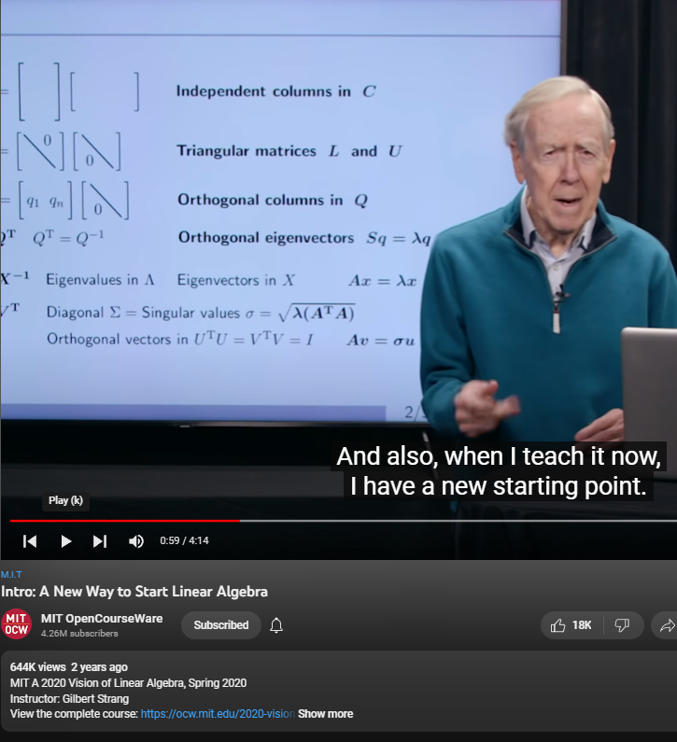
Recent Strang Lectures
https://ocw.mit.edu/courses/res-18-010-a-2020-vision-of-linear-algebra-spring-2020/

Slide 5
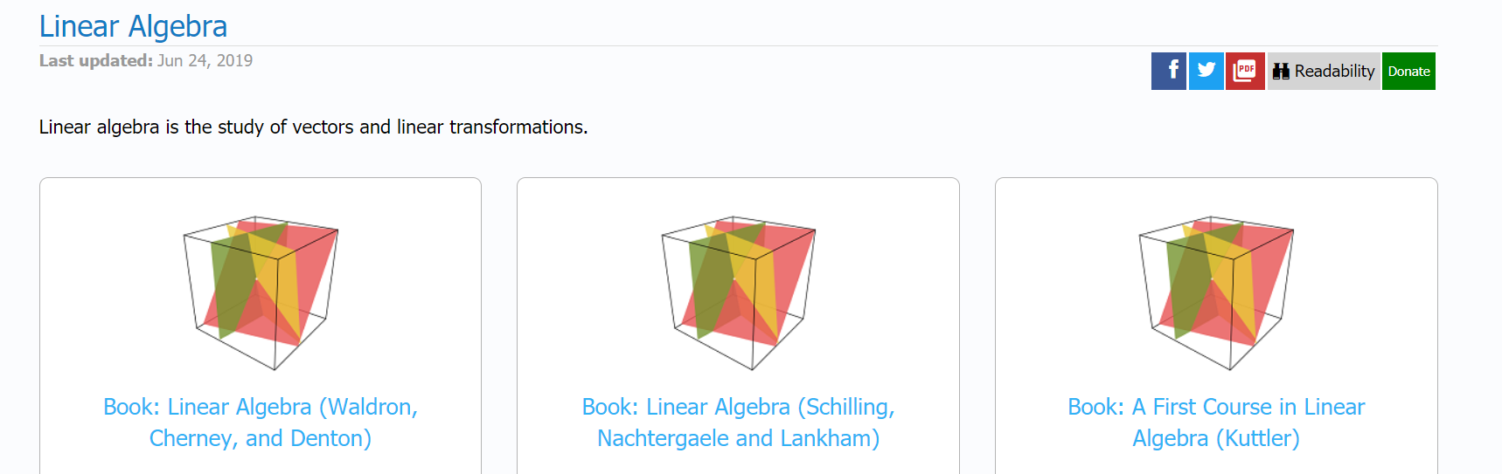

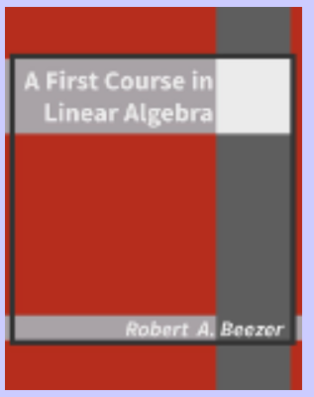
Free Linear Algebra Books
https://math.libretexts.org/Bookshelves/Linear_Algebra
https://www.math.ucdavis.edu/~linear/linear-guest.pdf
http://linear.ups.edu/

Slide 6
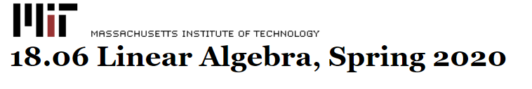
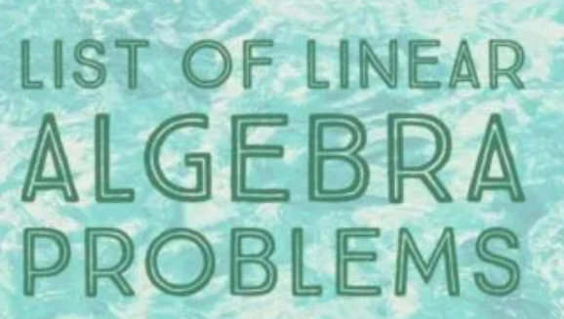
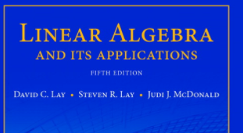
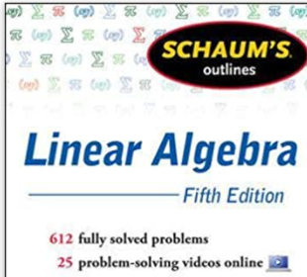
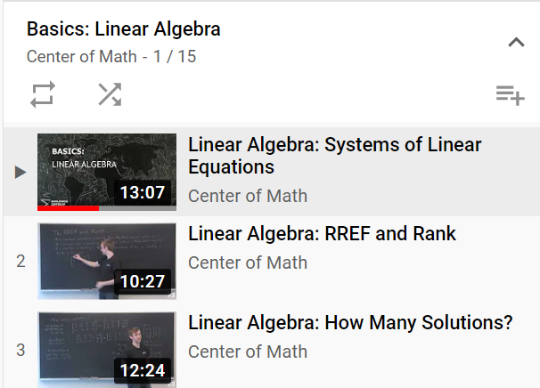
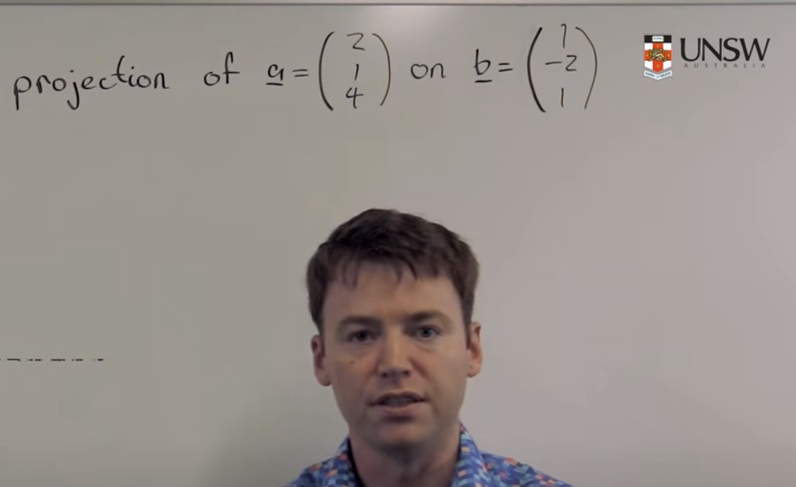
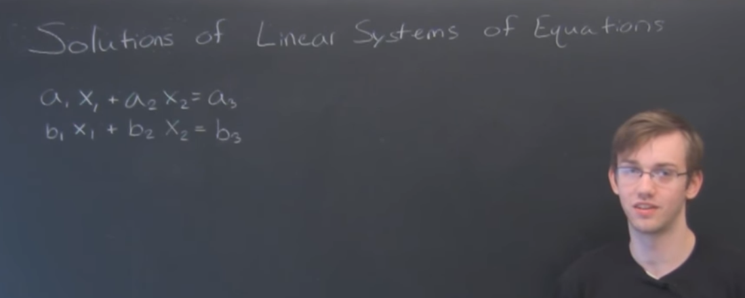
Worked examples
MIT 18.06 past questions:
https://mitmath.github.io/1806/old.html
Yutsumura’s worked examples:
https://yutsumura.com/introduction-to-linear-algebra/
Lay’s Linear Algebra 5th edition worked solution
(you will need to google the above)
Schaum Outline series : Linear Algebra
https://www.amazon.com/Schaums-Outline-Linear-Algebra-5th/dp/0071794565
UNSW – Maths: https://www.youtube.com/watch?v=usCWwRj2hO4
Center of Maths: https://www.youtube.com/watch?v=TICOi14fa6I&list=PLgKTLlHQn950Xm27KxcsX7Dr9Fxv_-gEi

Slide 7
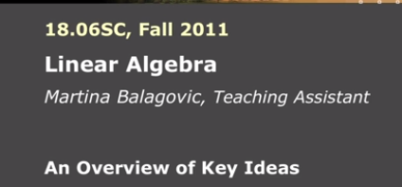
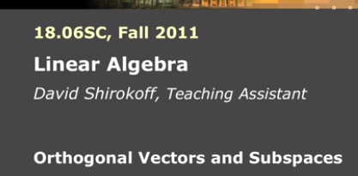
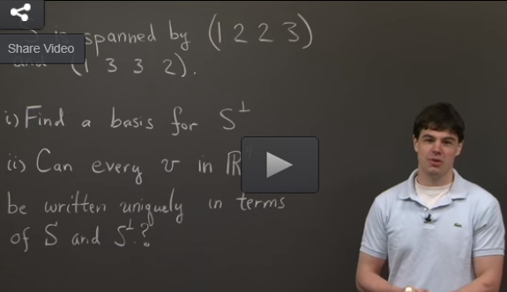
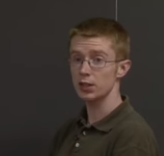
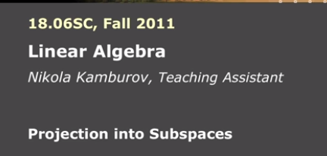
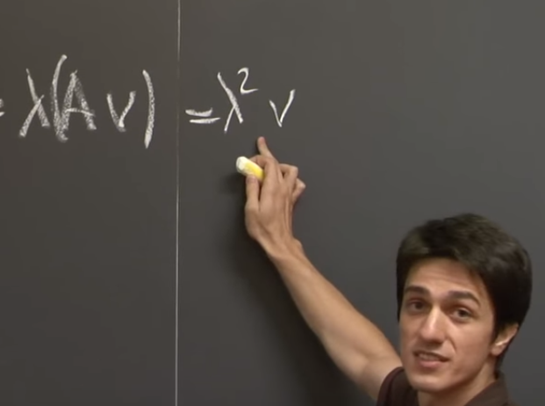
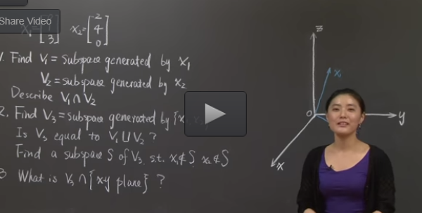
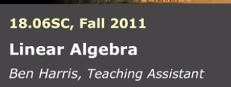
MIT worked examples:
MIT – tutorial (worked examples)
https://ocw.mit.edu/courses/mathematics/18-06sc-linear-algebra-fall-2011/

Slide 8


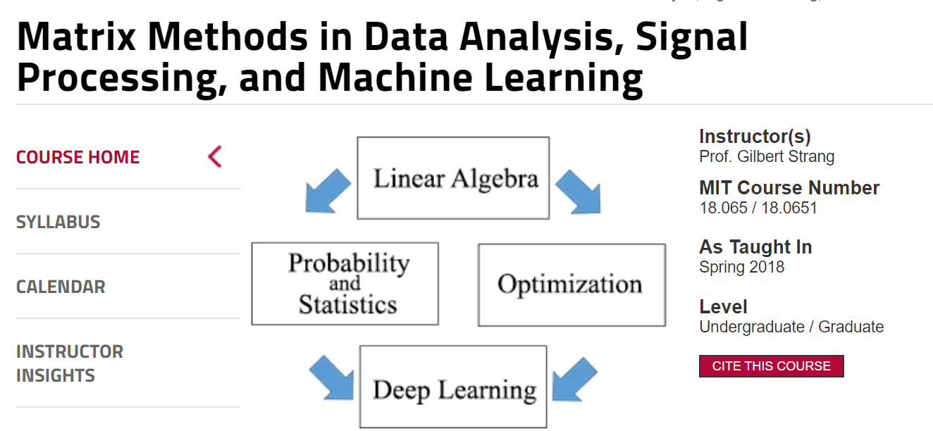
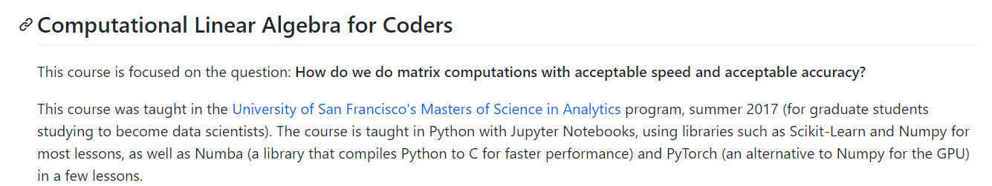
Recent resources
Medium: https://medium.com/sho-jp/tagged/linear-algebra
Computational Linear Algebra (Masters) – U of San Francisco (Masters)
https://github.com/fastai/numerical-linear-algebra/blob/master/README.md
https://www.youtube.com/playlist?list=PLtmWHNX-gukIc92m1K0P6bIOnZb-mg0hY
MIT Strang new course (Masters level):
MIT 18.065 Matrix Methods in Data Analysis, Signal Processing, and Machine Learning, Spring 2018
https://www.youtube.com/watch?v=Cx5Z-OslNWE

Slide 9
Some focus topics

Slide 10
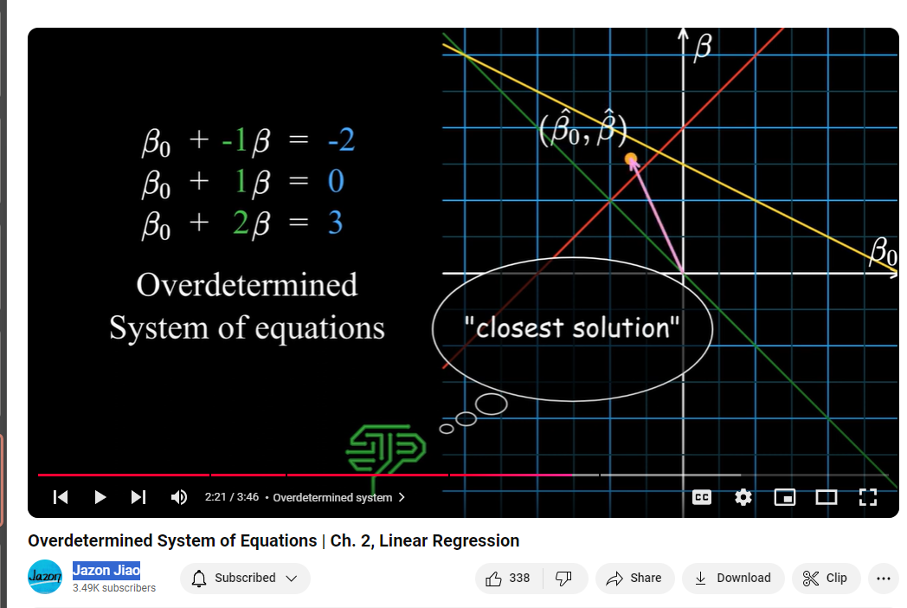
Visualizing equations
Jazon Jiao
https://youtu.be/3g-e2aiRfbU?si=br7JI5dnOhgKT_Jm

Slide 11
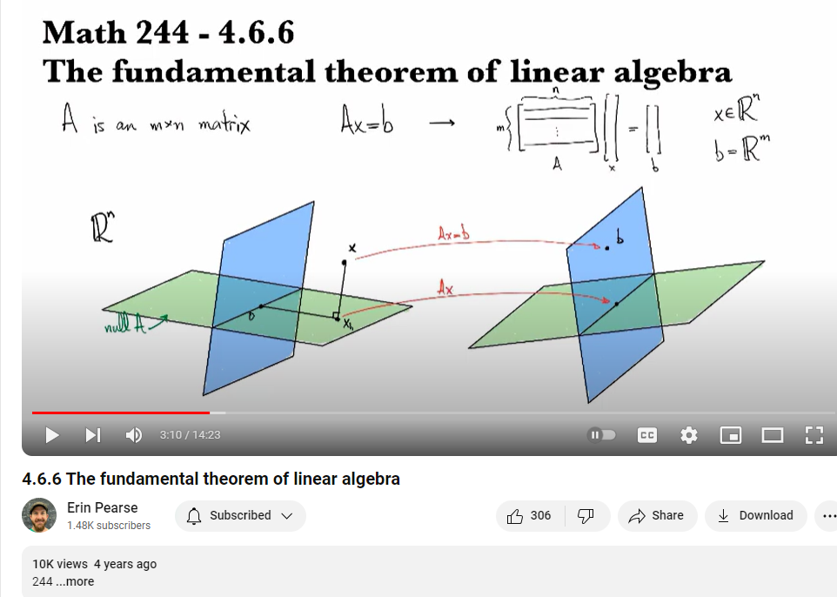
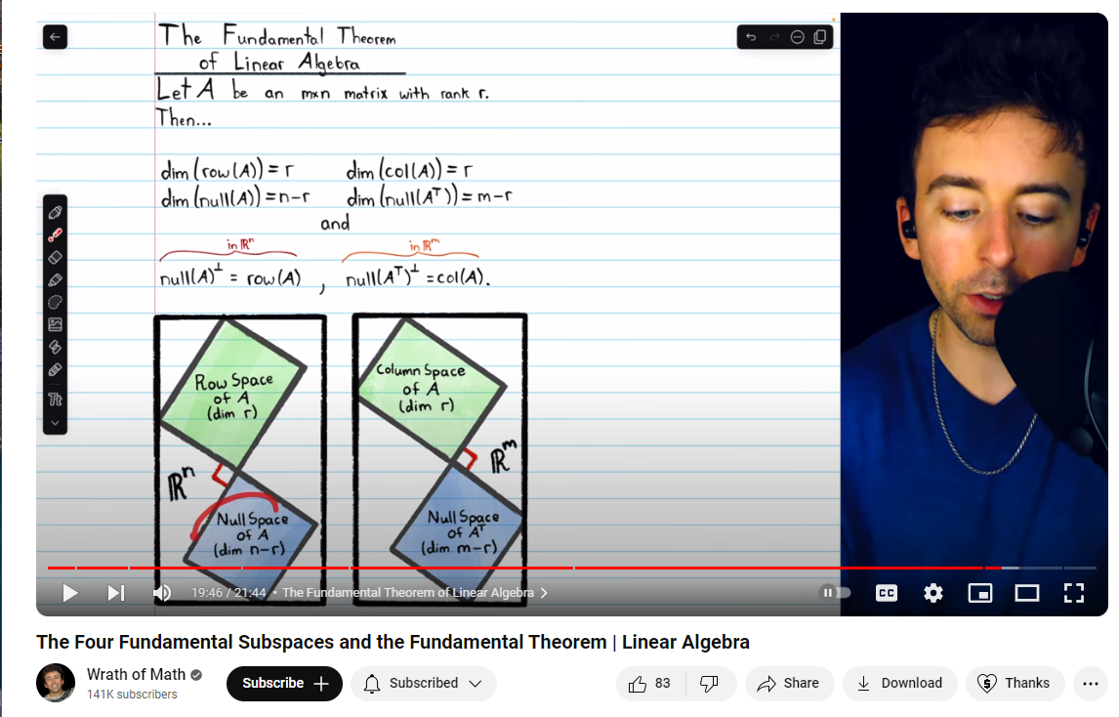
The four subspace
https://www.youtube.com/watch?v=eeGvVyesafw
4.6.6 The fundamental theorem of linear algebra

Slide 12
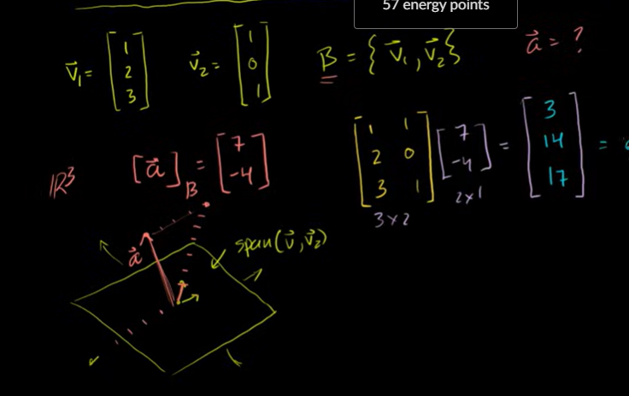
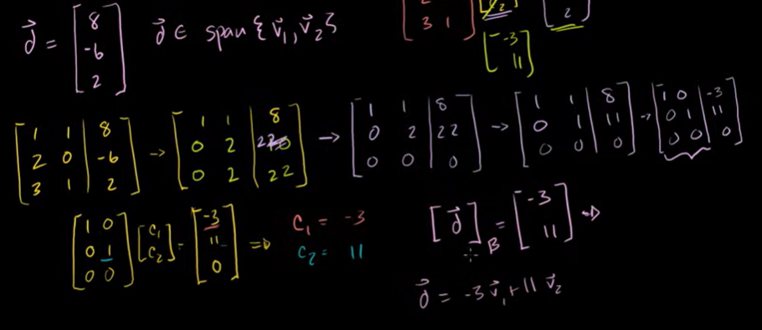
Change of basis
https://www.khanacademy.org/math/linear-algebra/alternate-bases/change-of-basis/v/linear-algebra-change-of-basis-matrix
2) The subspace W is span by v1,v2
In a 3-D space. This example shows
That the coordinate vector is a 2-D vector
With respect to the B basis consisting of
{v1,v2}

Slide 13
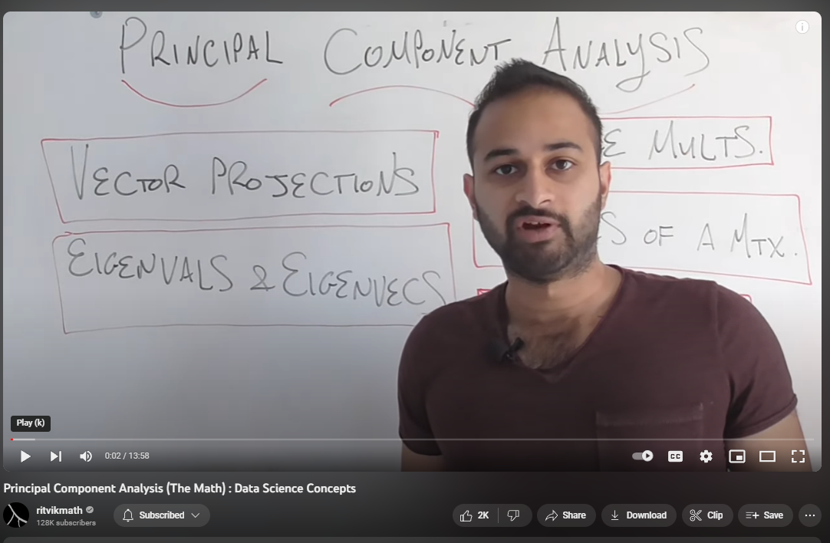
Data Science related
Ritvikmath: data science series: https://youtu.be/hEQ6j0eRDtg
- Principal Component Analysis (The Math) : Data Science Concepts:https://youtu.be/dhK8nbtii6I

Slide 14
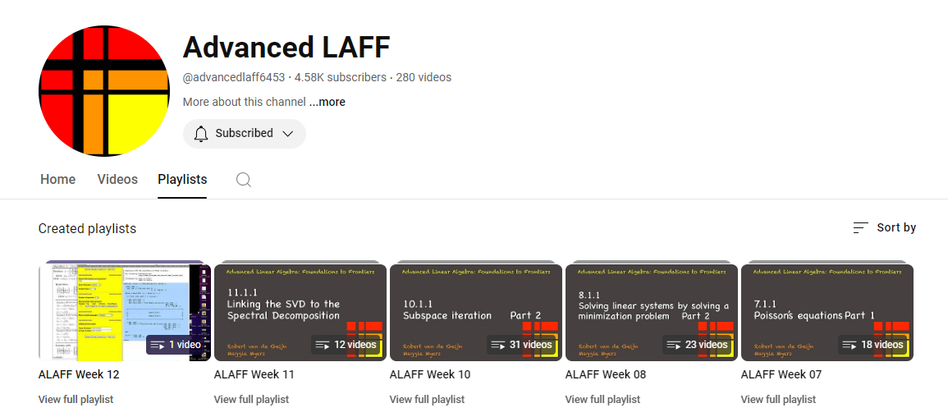
Advance Linear Algebra – second course
https://www.youtube.com/channel/UC-FlL9LPEipGNgaa1pS7aPg
http://www.ulaff.net/

